Slide 1

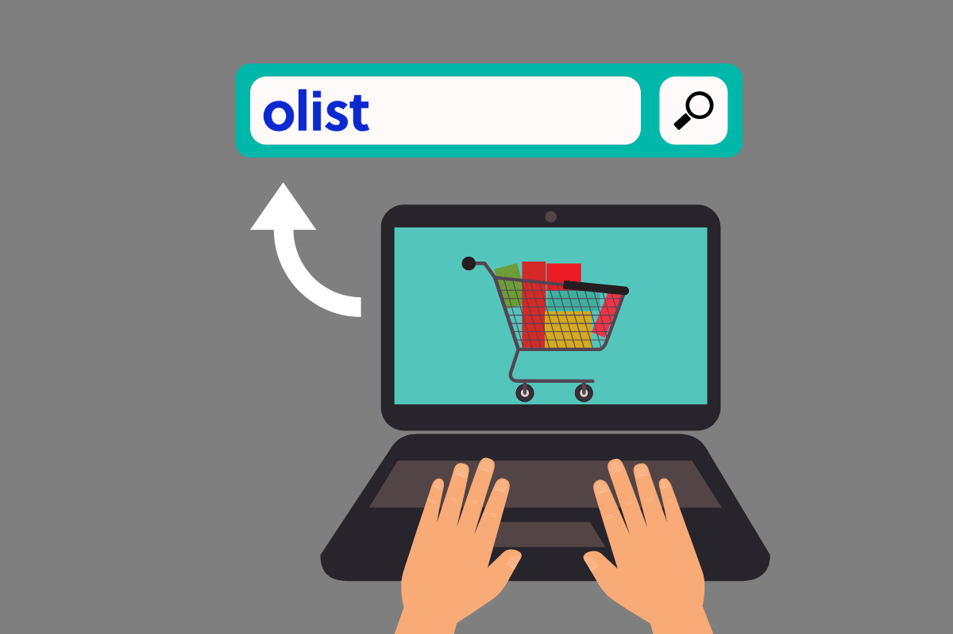
Sales Dashboard
Olist Store Analysis

Slide 2
Group Members
Ms Sunanda Jakani Hanumanthakari
Ms. BHAVYA C P
Ms. AMRUTHA M.S
Ms. Shruti Vinod Shukla
Mr. Tushar Machhindra Kalaskar
Miss. Rutuja Sunil Gunjal
sunandajakani5678@gmail.com
bhavzmalu@gmail.com
msamrutha557@gmail.com
shuklashruti1912@gmail.com
kalaskartushar1@gmail.com
rutujagunjal28@gmail.com

Slide 3
Introduction
Olist is an E- commerce company is a Brazilian department store platform which operates in the e-commerce segment.
The service consists of management of the sales process between shopkeepers and clients, and also includes a client satisfaction report.
The advantages for the shopkeepers is a better market presence and transparent reputation metrics and sells the products to customer directly through Olist’s store logistics.
DATABASE:
The dataset contains nearly for 100k orders of information from 2016 -2018 in Brazil’s market.
It allows to view an orders from multiple dimensions: order status, payment ,price, product attributes and freight performance to customer location, Review score given by customer.
Here 9 tables with datasets which are connected each other through common fields.

Slide 4

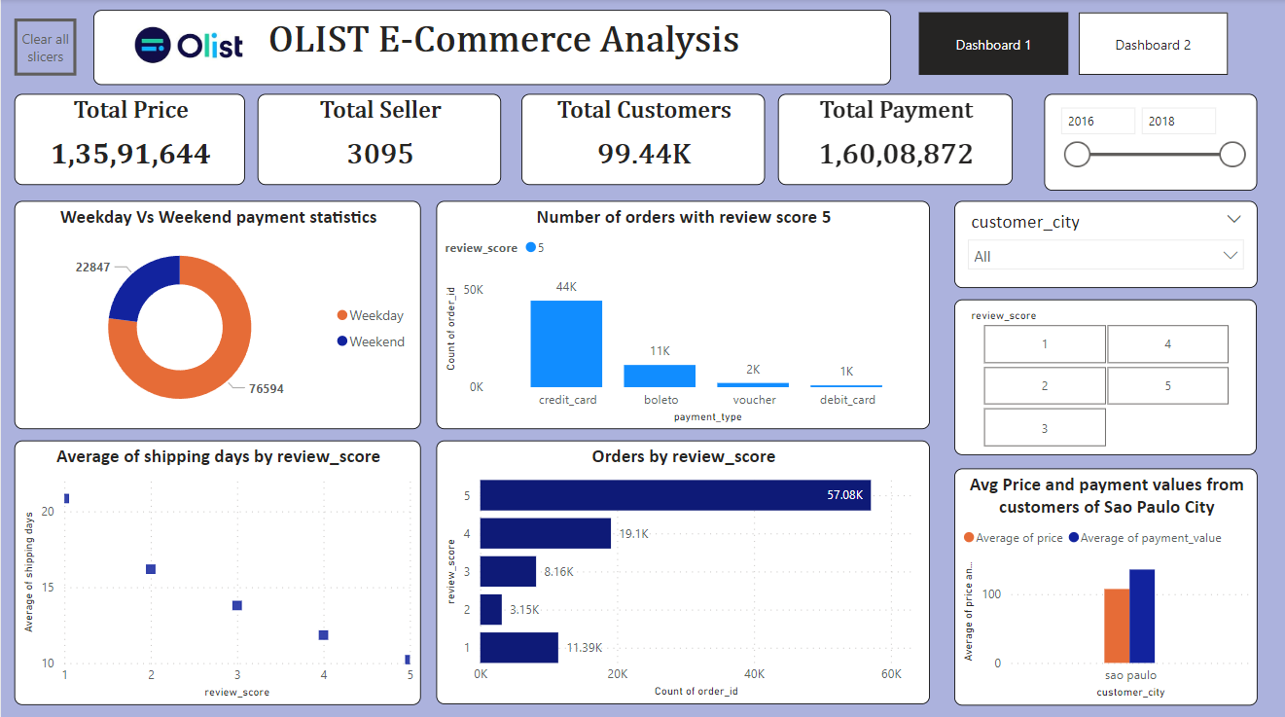
Dashboard

Slide 5
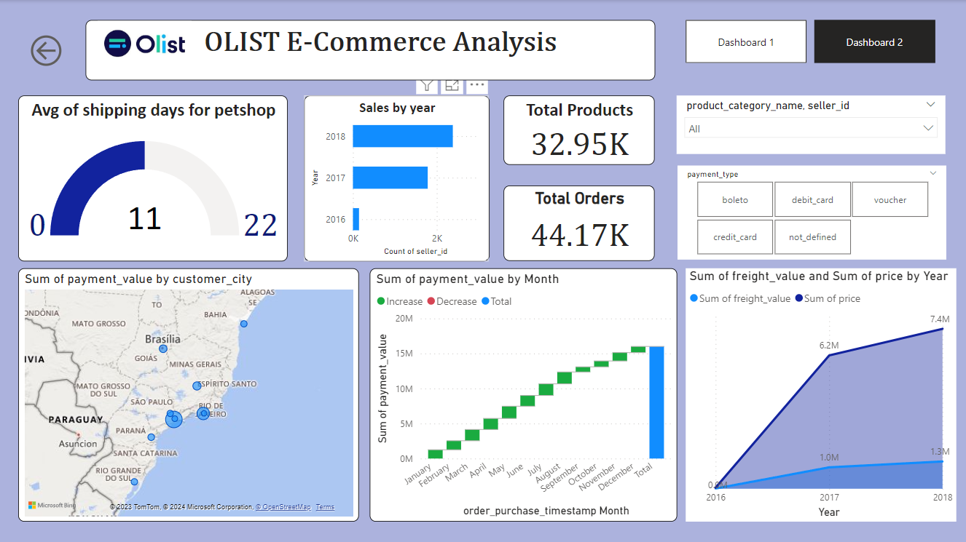
Dashboard

Slide 6
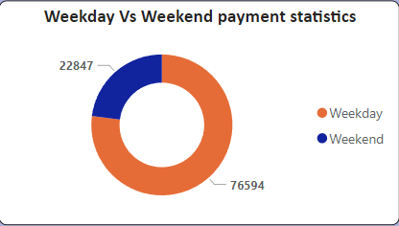
Weekday Vs Weekend Payment Statistics
Overview:
1. Most of the sales are done on weekdays.
2. The number of orders received on weekdays is 22847 and on weekends 76594.
Suggestion:
1. Offers and Discounts has to provide on weekends to balances the weekdays payments.
2. On Mondays ,New Products has to launch as payments count is more

Slide 7
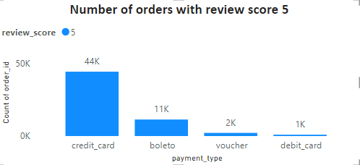
Number of Orders with review score 5 and payment type as credit card
Overview:
1. More orders have been placed via credit card payment than boleto, voucher, and debit card.
2. More than 70% of sales were paid by Credit Card which is the main payment method in the market. However, payment using Boleto has slightly increased by 7% and a significant increase in using a debit card has been founded.
Suggestion:
If we want to increase sales, we can have a certain amount of discounts or no-cost EMI’s on card payments.

Slide 8
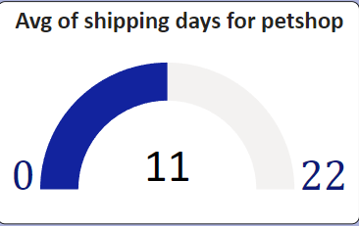
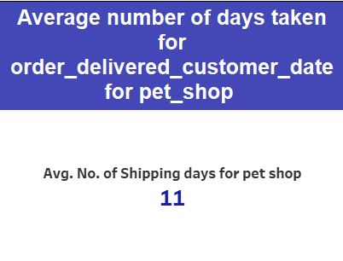
Average number of days taken to deliver order for pet_shop
Overview:
11 days is the avg days taken to deliver the order for pet shop.
Suggestion:
We can work on faster delivery of the product by taking additional delivery measures.

Slide 9
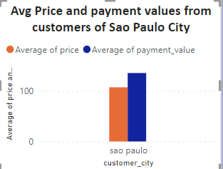
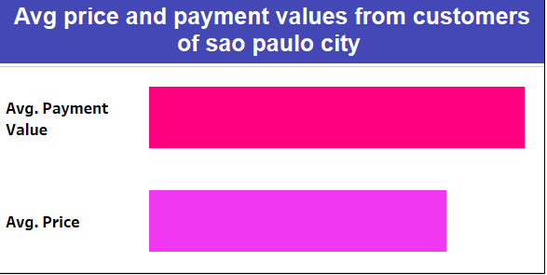
Average price and payment values from customers of sao paulo city
Overview:
1. Average Price for Sao Paulo city : $ 107.53.
2. Average Payment for Sao Paulo city: $ 135.83.
3. Here Avg Price and Avg Payments are increasing gradually every year.
Suggestion:
To increase sales on other cities we can work on faster delivery and easy payment modes.

Slide 10
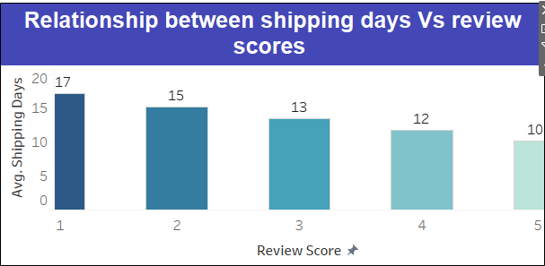
Relationship between shipping days Vs review scores.
Overview:
Here shipping days and Review Score are inversely proportional
Suggestion:
Minimizing the shipping days would lead to more positive reviews. Consecutively customer satisfaction will be met which leads to more business.

Slide 11
Conclusion
The analysis of the Olist Store project offers valuable perspectives on customer behavior and payment statistics.
Examining these Key Performance Indicators (KPIs) enables Olist to pinpoint areas for enhancement. We employed 'Excel,' 'Power BI,' and 'Tableau' to clean and transform the dataset, generating insightful visualizations in the process.
This project serves as a great example of how data analysis can help businesses make informed decisions.
This analysis also provides an overview of customer consumption trends and patterns that can be used to direct further business strategies.

Slide 12
Recommendation
Olist should focus on those categories with more than average delivery time and shorten the delivery time .
Olist should set the review score survey based on the product’s pricing, quality, delivery arrangement, and customer service aspects. It would help to build a comprehensive score review.
Regularly monitor and analyze customer reviews to gain insights in product quality and identify areas for improvement & together with proper shipment tracking and communication system can improve Olist's delivery.

Slide 13
Thank You !

